Slide 1
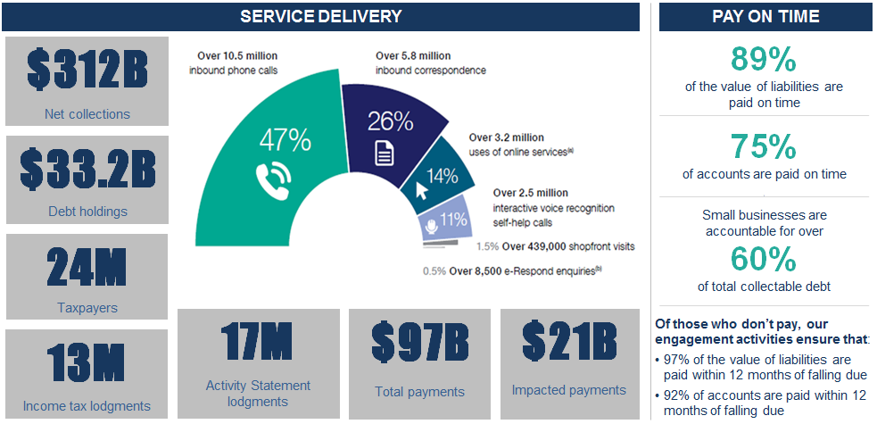
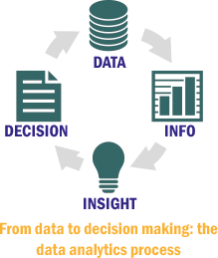
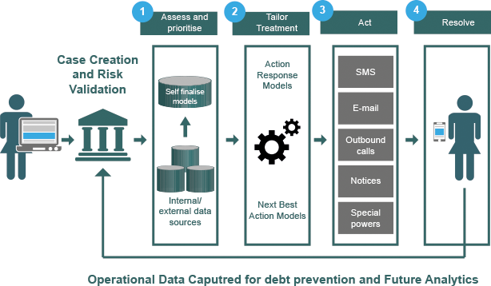
THE REINVENTION JOURNEY
HOW DATA IS LEADING THE WAY
Provide self-help and online services and easy payment solutions. By using data in smarter ways, advancing our analytics capability to optimise our case selection and debt collection.
ATO GOALS AND STRATEGIC INTENT
Willing and easy participation
GOALS
Professional and productive organisation
Using data in a smarter ways to improve decisions, services and compliance
Sharing intelligence and data with tax agencies worldwide to support voluntary compliance and identifying and investigating tax evasion
Improving and extending our data matching and our pre-filling services
Developing better-targeted services based on an understanding of taxpayers’ needs and behaviours
Establishing a holistic view of taxpayer risk to improve our service
Supporting our transformation to a digital enterprise while ensuring the integrity and availability of production systems
Enhancing our data mining and analytics capabilities to enable the real time identification of potential risk and appropriate responses
Contemporary and tailored service
Purposeful and respectful relationships
89%
of the value of liabilities are
paid on time
75%
of accounts are paid on time
\
Small businesses are
accountable for over
60%
of total collectable debt
89%
75%
60%
OUR DATA ANALYTICS PROCESS
THE DEBT APPLICATION
Operational Data captured for debt prevention and Future Analytics

